Slide 1
University American College Skopje
Course: Computer Applications 1
Getting started with Office Applications
Marija Stanojeska, PhD

Slide 2
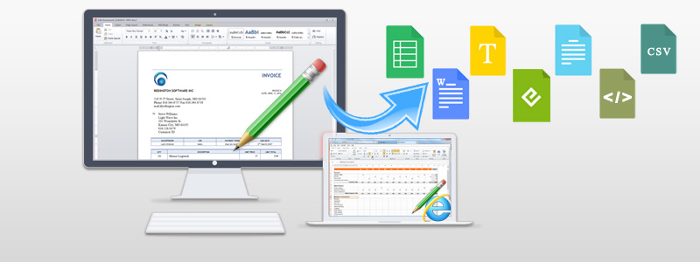
Based on the textbook:
Microsoft Office Inside Out (Office 2021 and Microsoft 365), J. Habraken, Pearson Education, Inc., 2022.

Slide 3
Navigating and customizing the Office interface
The Microsoft Oﬃce applications are designed to make it easy for you to concentrate on your work, whether it is a Word document, Excel Worksheet, or a PowerPoint slide presentation. These powerful applications are also designed so that you can quickly access the commands and features that you need to get the job done.
The Oﬃce suite applications’ easy-to-use interface centers around the ribbon, which is the place to go when you need to access an application command or feature. In this chapter, we take a look at the interface shared by the Oﬃce applications (primarily Word, Excel, and PowerPoint and explore how to stay productive as you navigate the various command elements, such as the ribbon tabs, galleries, dialog boxes, task panes, and even the status bar.

Slide 4
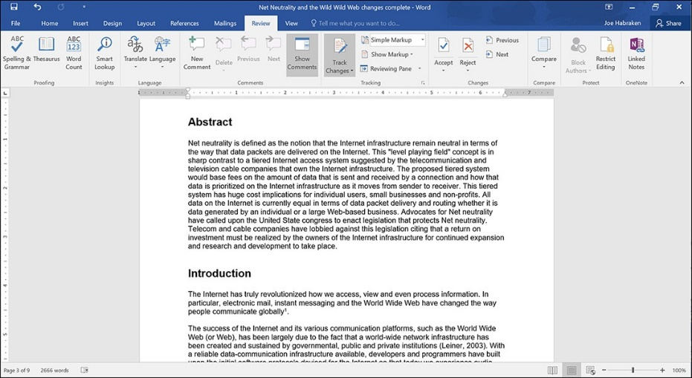
Getting familiar with the Office interface
The Oﬃce applications employ a ribbon-dominated user interface that uses each ribbon tab to group commands into somewhat broad yet related categories. For example, in Word, the Review tab provides groups of commands related to reviewing and ﬁnalizing a document. These groups include the Prooﬁng group, the Language group, the Comments group, the Tracking group, the Changes group, the Compare group, and the Protect group. All these groups provide commands related to reviewing and ﬁne-tuning a Word document. Most of us will at least take advantage of the Spelling & Grammar command in the Prooﬁng group if not other commands and features provided on the Review tab.
The Oﬃce user interface does its best provide consistency across the Oﬃce applications. The Home tab in the Word, Excel, PowerPoint, or Publisher application window contains the Clipboard group and other groups related to font formatting, text alignment, and styles.
Considering the diﬀerent purposes of the Oﬃce applications, the ribbon tabs and accompanying command groups obviously vary from application to application in the Oﬃce suite.
Ribbon tabs house related command groups

Slide 5
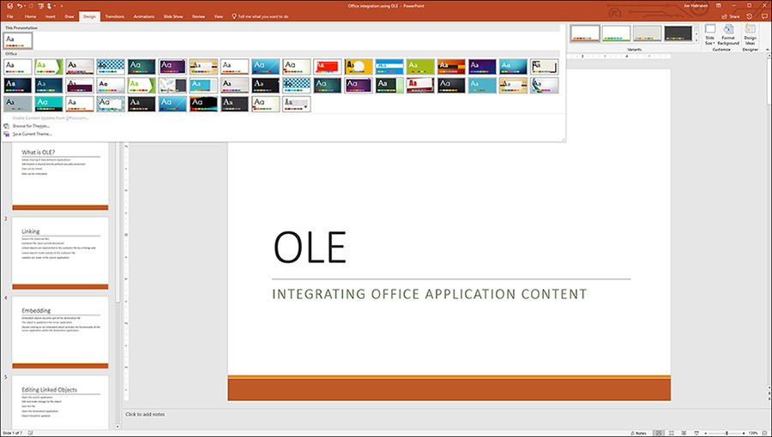
Galleries
A gallery supplies the actual results related to a command. For example, if you want to apply a theme to a PowerPoint presentation, access the Design tab and select from the available theme choices.

Slide 6
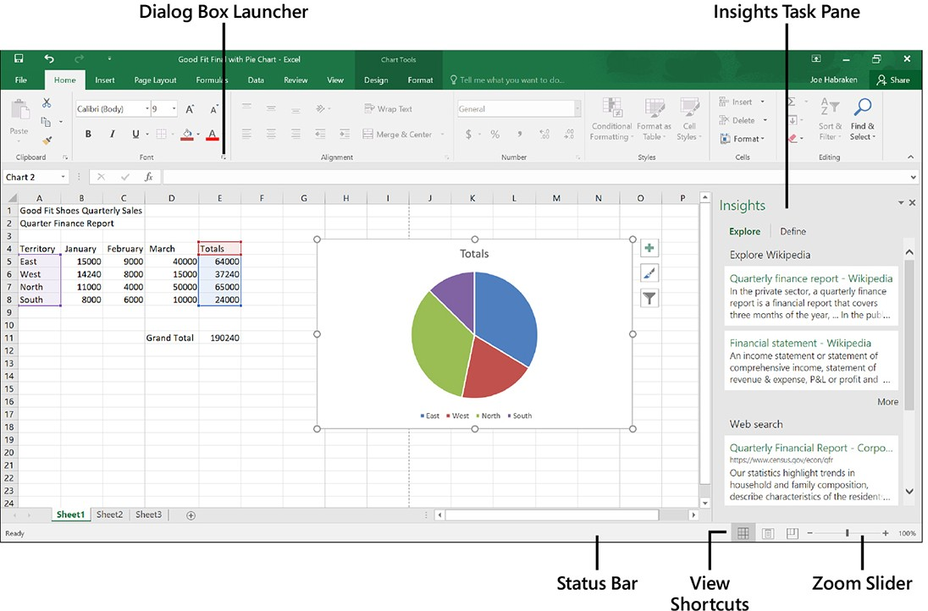
Overview of the Office application window
If you are new to the Oﬃce interface, it makes sense to take some time to gain familiarity with its various parts. Figure shows the Excel application window. You will ﬁnd that the most often used Oﬃce applications (Word, Excel, and PowerPoint) have very similar workspace geographies.
The Excel application window

Slide 7
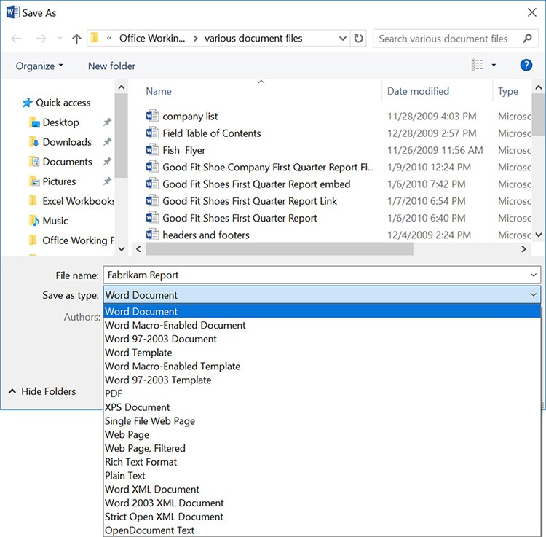
Saving files as different file types
When you create a new Word document, Excel workbook, or PowerPoint presentation, you eventually need to save your work to a file. Each of these applications uses the open XML file format by default. So, if you save a new Word document and do not change the Save As Type setting, you get a file with the extension .docx (the open XML format for Word).
When you save a file for the first time, the Save As dialog box opens. At a minimum, you must provide a file name for the new file, and you have the option of specifying the location where the file will be saved.
Selecting the file type for a Word document

Slide 8
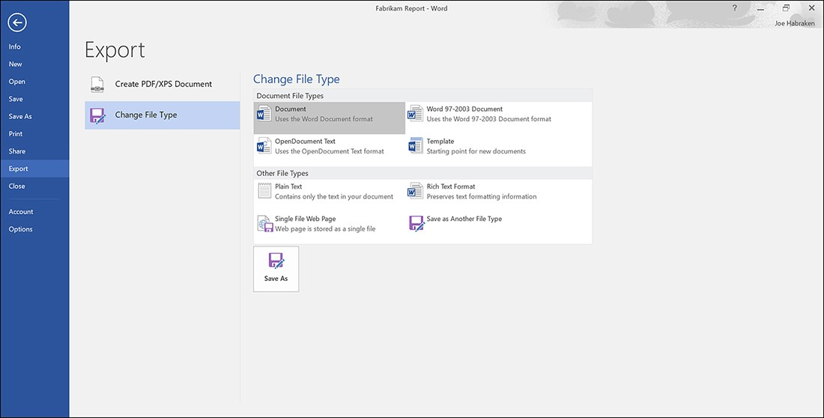
Converting files different file types
The Export page provides two possibilities: Create PDF/XPS Document and Change File Type. By default, the Create PDF/XPS Document is selected on the Export page, so to quickly create a PDF or XPS "copy" of the current file, click the Create PDF/XPS button. When the Publish As PDF Or XPS dialog box opens, it looks much like the Save As dialog box. By default, the file is saved as a PDF, but you can switch to XPS using the Save As Type drop-down menu. Specify a location file name, and then select Publish to save the PDF (or XPS) file. To create a copy of the current file in a new file type, select one of the alternative file types provided in the Change File Type pane. For example, you might want to save an Excel workbook that is currently in the Excel .xlsx file format (the default) to the Excel 97–2003 workbook file type (.xls) so that you can share the file with a colleague who uses an earlier version of Excel.
The Export page and the Excel Change File Type pane

Slide 9
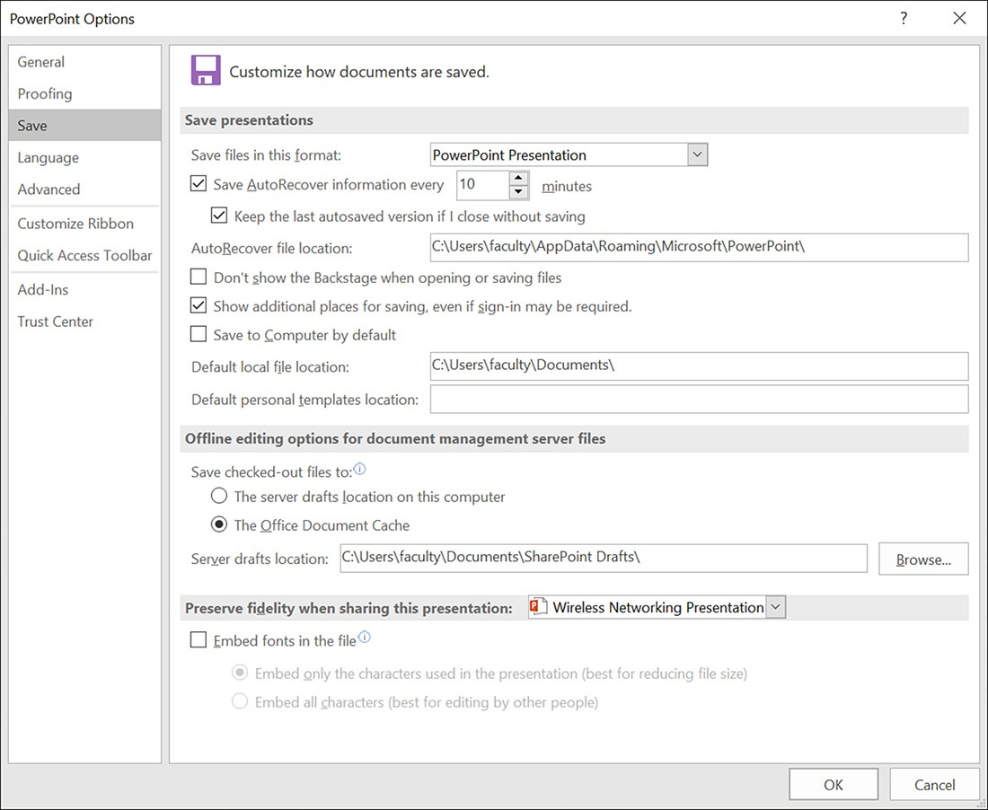
Converting save files options
The Save options for Word and Excel are similar.
The PowerPoint Save options

Slide 10
Creating and managing files
You can take advantage of themes and templates in Excel, Word, PowerPoint, and Publisher. To start a new file based on a template or theme, follow these steps:
Select File to open the Backstage.
Select New in the Backstage. The New page opens (which is similar to the Start screen). Figure 3-6 shows the Excel New page.
Select a template or theme in the New window to preview the template or theme. The Preview window also describes the theme or template.
If you want to search for an online template or theme, select one of the suggested searches at the top of the New page or enter keywords in the Search box and run the search.
The search results show all the templates available online that match your search criteria.
On the right side of the Search results, you find a Category list. The categories listed are keyword subsets of all the templates that were found using your search terms. Each category has a number to the right showing how many of the listed templates fall into the category. You can view a subset of the search results by selecting a category.
If you selected a template stored locally on your computer, click Create. If the template is an Office.com template, click Download. In either case, a new file opens in the application window based on the template.

Slide 11
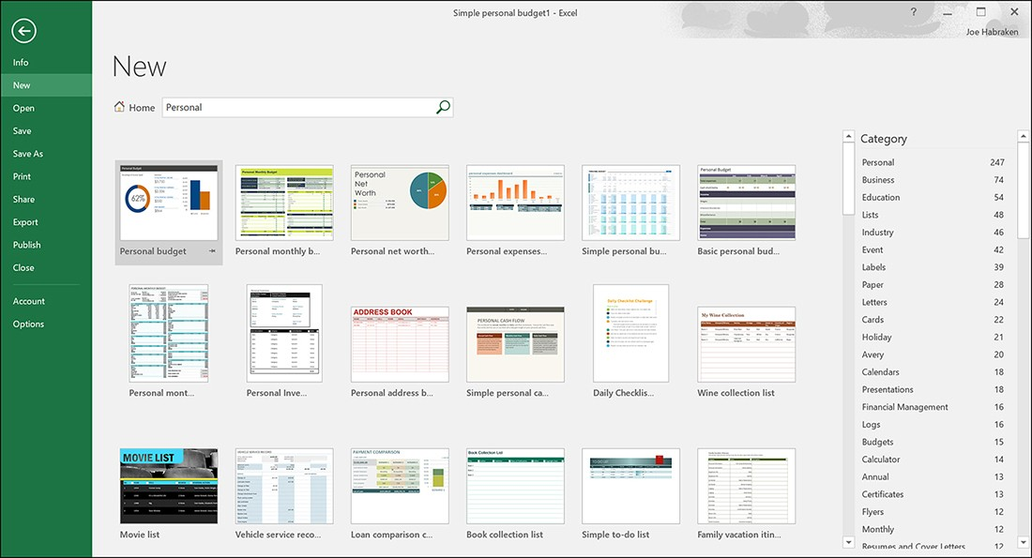
Creating and managing files (cont.)
Create a new file based on a template or theme.

Slide 12
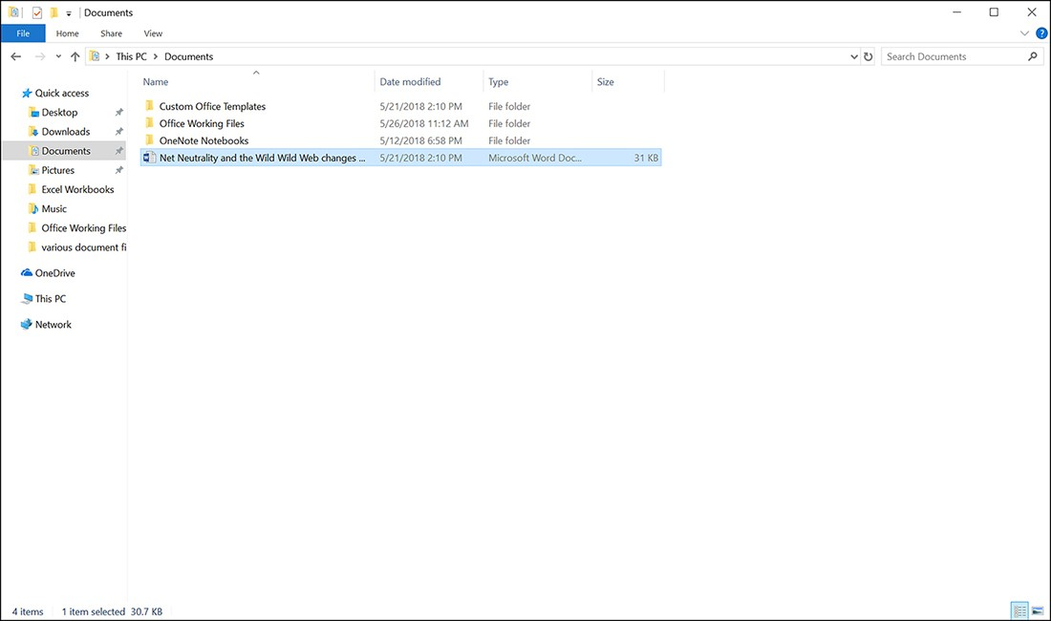
Creating a new folder
You can create new folders on any drive or in existing folders, such as the Documents folder. Navigate to the drive or folder you want to serve as the parent container, and then click the New Folder button on File Explorer's ribbon. Type a new name for the folder, and you are good to go. You can drag existing files and folders into the new folder (using File Explorer) and specify the new folder when you save a file in the Save As dialog box.
Create new libraries or folders using File Explorer

Slide 13
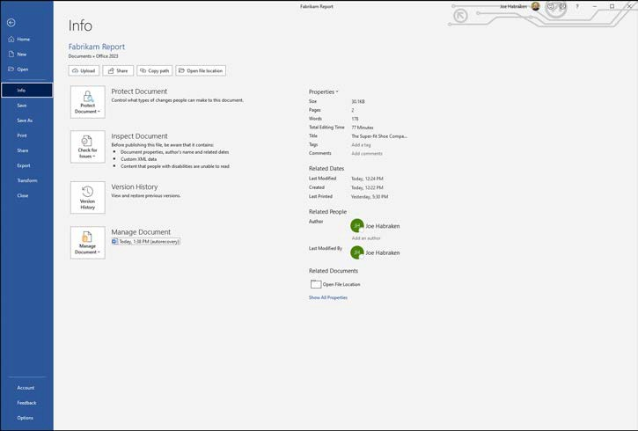
Working in the backstage
To view any unsaved versions of the current file, such as a Word document, select File to open the Backstage and then click Info. The area of interest in this window is the Manage Document area.
The Word info page

Slide 14
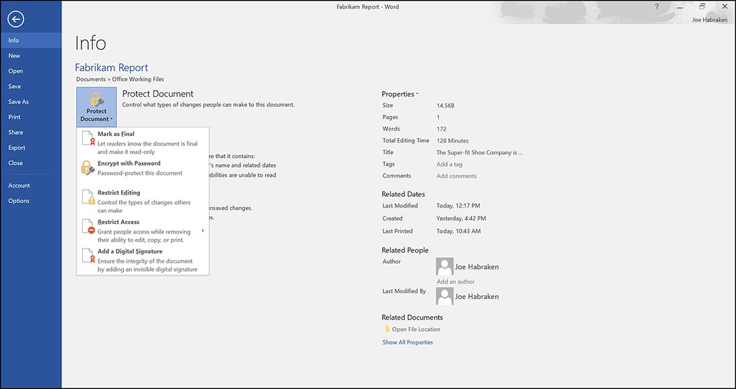
Protecting an Office file
The 365 applications enable you to protect a file (such as a document or workbook) that is shared with other users (particularly users on a network). The Protect Document settings help protect the content of the file and can also potentially restrict what can be changed in the document and by whom. To view these options, click the Protect Document button in the Info window, as shown in Figure.
Select a document protection strategy on the Info page

Slide 15
Protecting a Office file (cont.)
The following options are available:
Always Open Read-Only: When you choose this option, documents you share are opened in read-only mode. This feature is primarily designed to keep users from making changes to a file upon first inspection.
Encrypt With Password: The file is encrypted and protected with a password. When you select this option, you are required to enter a password for the file. Only users with the password can open the file.
Restrict Editing: This command opens the Restrict Formatting and Editing task pane in the document, presentation, or worksheet window. You can restrict formatting to a selection of styles and specify editing restrictions for the document, including making the document read-only.
Restrict Access: This option enables you to take advantage of a Digital Rights Management server. This type of service allows you to assign users different permission levels for the file.
Add A Digital Signature: You can digitally sign a file to prove its authenticity. Signing a file digitally requires that you obtain a digital certificate. A certificate authority can provide digital certificates.
Mark As Final: This command marks the file as final and makes the file read-only. All editing commands for the file are disabled; however, any user opening the document can remove the Mark As Final setting in the Backstage.

Slide 16
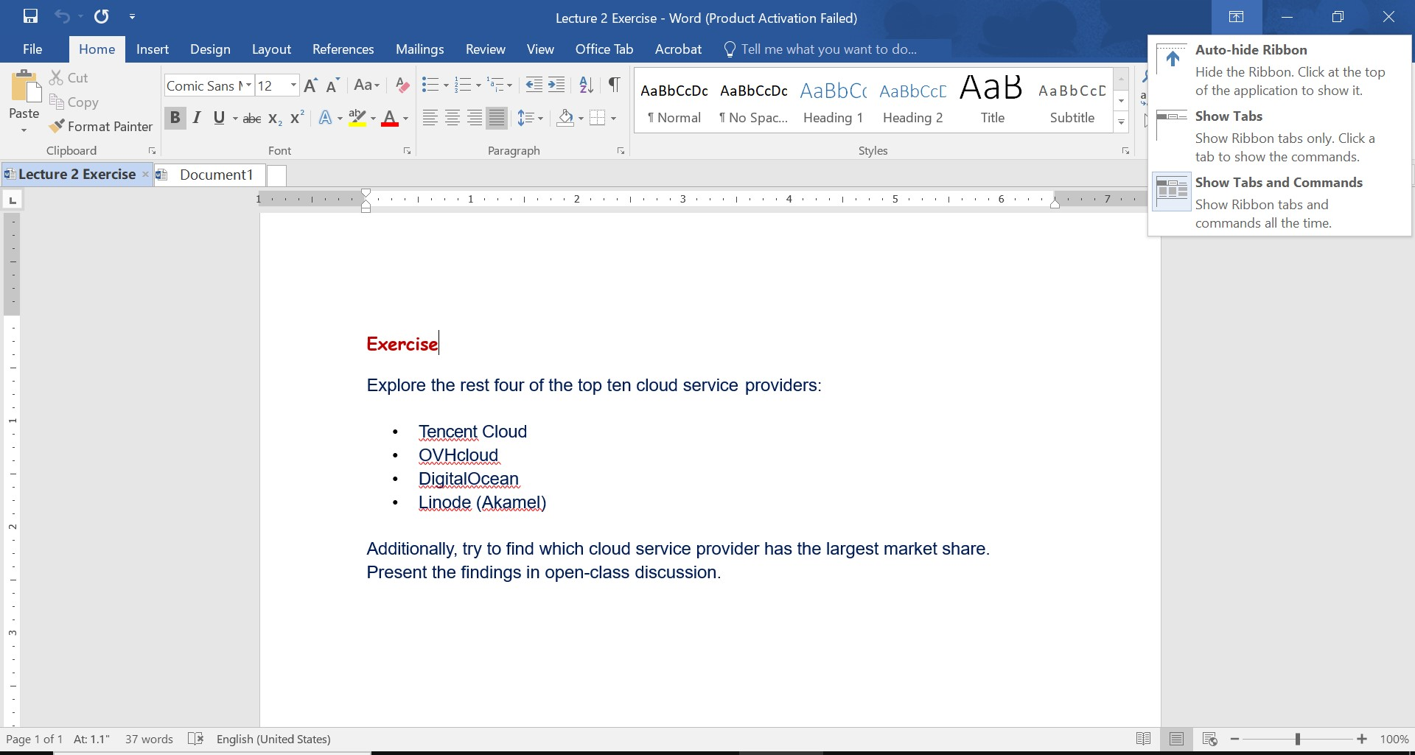
Working with the ribbon
The ribbon tabs provide a results-driven grouping of application commands that places closely related commands into speciﬁc groups. Accessing ribbon commands is just a matter of selecting the appropriate ribbon tab and then accessing the command you want from a group on that tab. The ribbon Display Options button gives you three options for dealing with the ribbon:
Auto-Hide Ribbon: This option hides the ribbon. You can access the ribbon by clicking at the top of the application window.
Show Tabs: This option shows the ribbon tabs only. Click a tab to view the associated commands.
Show Tabs And Commands: This option is the default setting and shows the entire ribbon, including the tabs and the commands available on the currently selected tab.

Slide 17
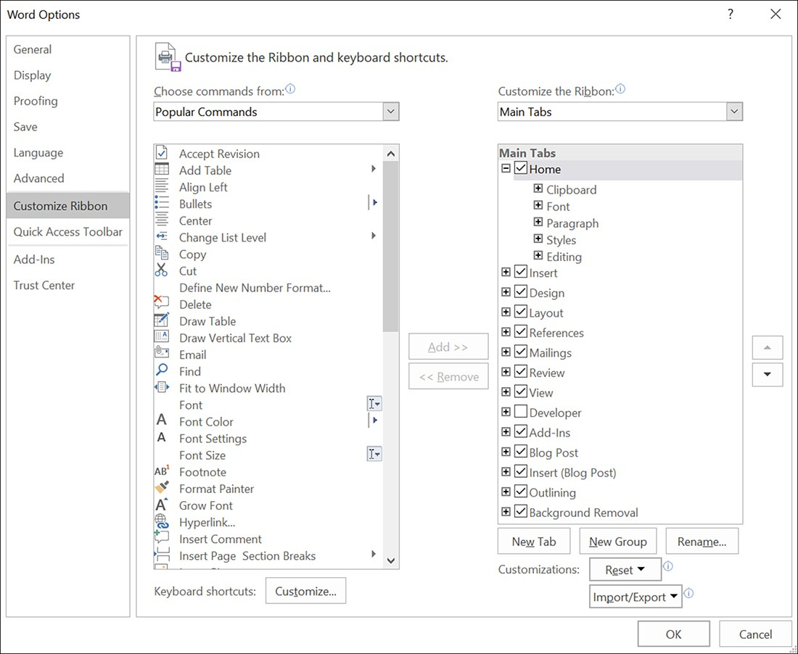
Customizing the ribbon
Each Options window provides an options list on the left side of the window. To work with the ribbon, select Customize ribbon (File – Options – Customize Ribbon).
The Word Options window with Customize Ribbon selected

Slide 18
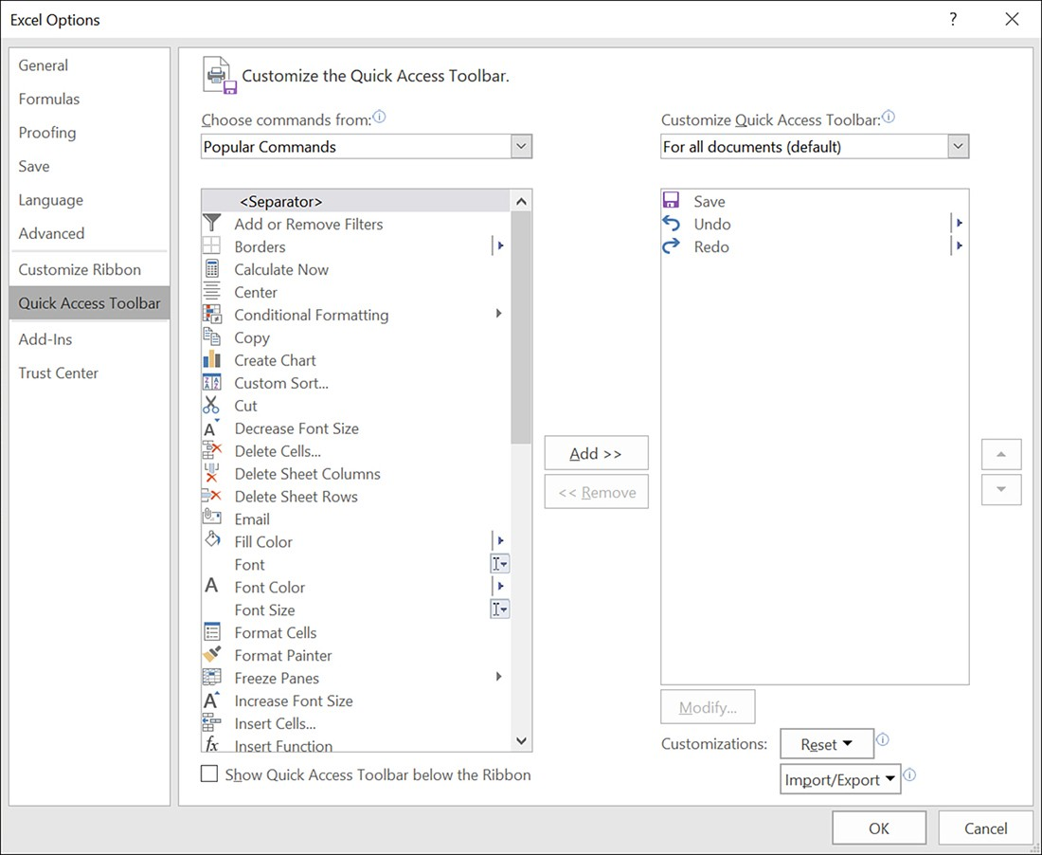
Customizing the Quick Access Toolbar
You can also add commands to the Quick Access Toolbar, which resides in the upper left of the Oﬃce application windows. Click the Customize Quick Access Toolbar button to the right of the Quick Access Toolbar to access the Customize menu. When you want to add a command button to the toolbar, select a command on the menu. A check mark appears to the left of the command, and the command button is placed on the Quick Access Toolbar. You can also remove any command button from the toolbar by deselecting it on the menu (File – Options – Quick Access Toolbar).
Customize The Quick Access Toolbar in the Options window

Slide 19
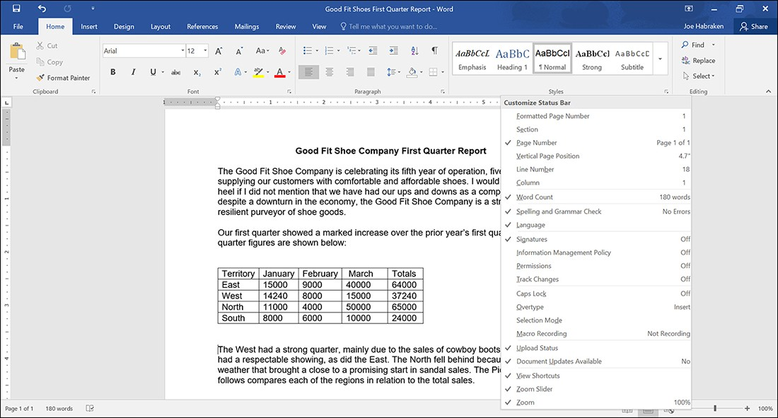
Customizing the status bar
The Oﬃce applications’ status bar is customizable, allowing you to determine what kind of information it provides. Zoom tools are on the right side of the status bar and let you control your view of your document in the application window.
You can also place options on the status bar that perform an action when you click them. For example, in Word, you can add Word Count to the status bar and use it to quickly open the Word Count dialog box and view the statistics for the document.
Customize The Status Bar

Slide 20
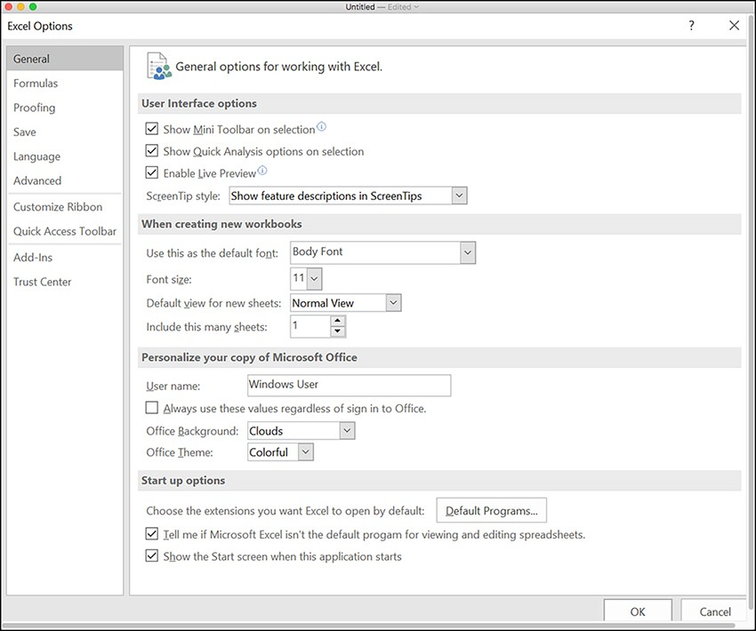
Configuring applications options
Microsoft has done a good job of making the tools for conﬁguring the various Oﬃce members extremely consistent across the applications. Some diﬀerences exist in the conﬁguration options provided for the Oﬃce applications because each application serves a diﬀerent function. For example, Excel has a Formulas option category, which makes sense because of Excel’s capability to do calculations. In Outlook, conﬁguration options are available for the Calendar, contacts, and mail, which makes sense because of the type of work you do in Outlook. All the applications in the Oﬃce suite provide an Options link in the Backstage. Select File and then Options to open an application’s Options window.
Excel General Options window

Slide 21
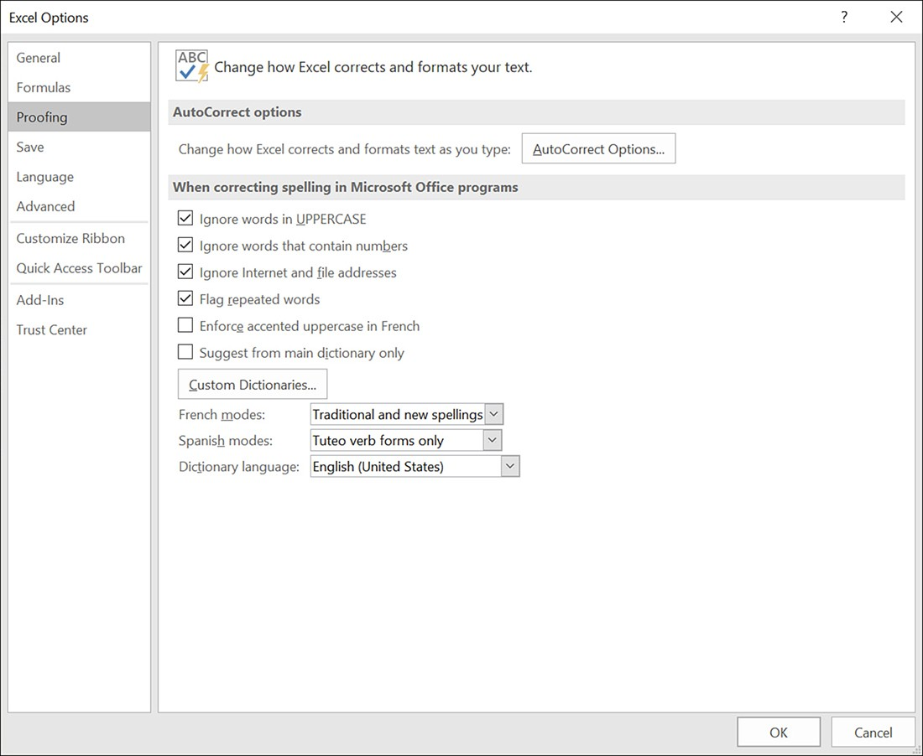
Configuring applications options (cont.)
Two other option categories contain settings that can aﬀect multiple Oﬃce applications: Prooﬁng and Language. The Prooﬁng options enable you to set the AutoCorrect settings speciﬁcally for an application. However, when you select options related to how spelling is corrected in the application or the default dictionary language, other applications also use those settings (File – Options – Proofing and Language).
Excel Prooﬁng options

Slide 22
Advanced options settings
Editing Options:
These options relate to editing and selecting items in the application. For example, Word provides an Editing option related to whether selected text is replaced when you type. Excel provides an Editing option that enables or disables Auto-Complete. Look for features in this subcategory that make it easier for you to select and edit information in the applications.
Cut, Copy, and Paste:
True to their names, these options relate to settings such as whether the Paste Options button is enabled when you paste an item. These settings also include Word formatting options related to pasting within the same document, between documents, or between programs.
Display:
This set of options provides settings for the number of recent ﬁles that are displayed in the Backstage and contains other settings related to whether formatting marks, such as tab characters and spaces, are shown on the screen.
Print:
This options relate to the quality of certain objects when they are printed. For example, in Excel, you can set a high- quality mode for graphics. In PowerPoint, you can specify that all printing is high quality. Word and PowerPoint also provide options for background printing so that you can continue to use the application as you are printing.

Slide 23
The Office options for graphics and pictures
The Oﬃce applications oﬀer you ample ways of enhancing the ﬁles you create with graphics. Options for graphics range from basic shapes to the insertion of customizable SmartArt graphics, to your own digital images. How you use graphics in your Oﬃce application documents is as important as the type of graphics you use. Graphics are meant to enhance a Word document, Excel worksheet, or PowerPoint slide.
The Oﬃce applications provide diﬀerent types of graphical elements:
Picture - The Oﬃce applications support diﬀerent ﬁle formats, including Windows Bitmap (. bmp), Graphics Interchange Format (. gif), Joint Photographic Experts Group (. jpg), Portable Network Graphics (. png), and Tagged Image File Format (. tif) formats.
Shapes - A Shapes gallery provides diﬀerent shape categories that make it easy to add lines, rectangles, stars, and even callouts to your Oﬃce documents.
SmartArt - This graphic type provides SmartArt diagrams, which include lists, processes, hierarchies, and relationships.
Screenshot - This tool gives you the ability to take a snapshot of the Windows desktop and any windows open on the desktop.
WordArt - WordArt styles provide a quick way to add special eﬀects to text in objects such as text boxes and diﬀerent text options (formatting possibilities), including Shadow, Reﬂection, Glow, Soft Edges, and 3D Format.

Slide 24
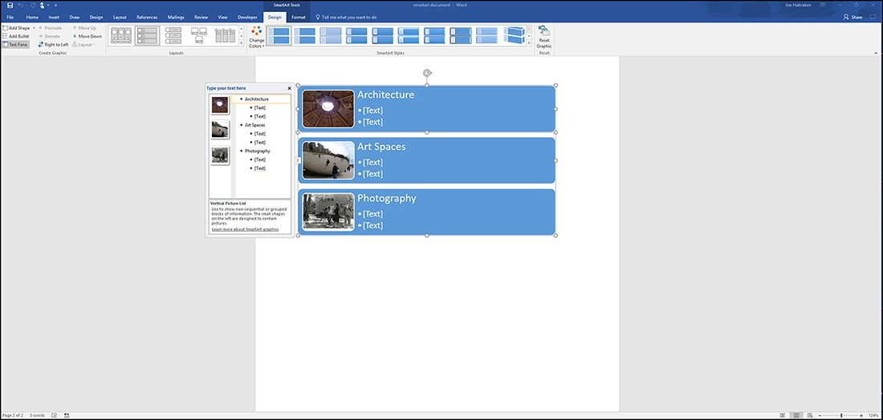
Working with SmartArt graphics
SmartArt provides a large gallery of complex graphical elements that you can use to create eye-catching lists and diagrams. You can create lists that use shapes to better deﬁne the relationship between text entries in a list, and you can create lists that make it easy to combine text and pictures.
A SmartArt vertical picture list in Word

Slide 25
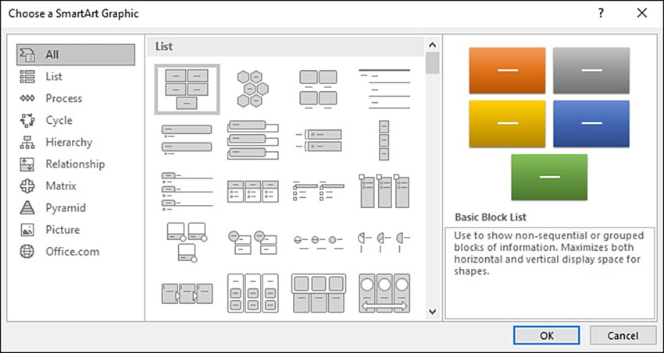
Inserting SmartArt graphics
SmartArt graphics are inserted using the SmartArt command, which is housed in the Illustration group on the ribbon’s Insert tab. To insert SmartArt into an Oﬃce document, follow these steps:
On the Insert tab, select SmartArt. The Choose SmartArt Graphic dialog box opens, as shown in
Select a SmartArt category to view the individual diagrams provided by a particular category.
Select the list or diagram you want to insert.
Click OK. The list or diagram is inserted into your current Oﬃce document.
The Choose A SmartArt Graphic dialog box

Slide 26
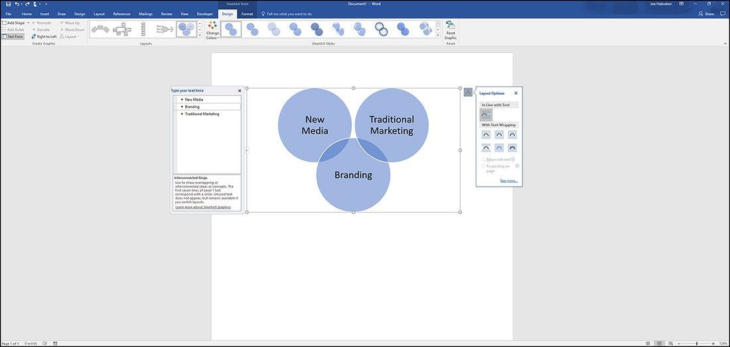
Inserting SmartArt graphics
You can now enter the text that you want to place in the diagram. Figure shows a Venn diagram SmartArt graphic that has been inserted into a Word document.
You can enter the text for the diagram directly onto the diagram parts by replacing any of the [TEXT] placeholders.
Enter the text for the SmartArt list or diagram

Slide 27
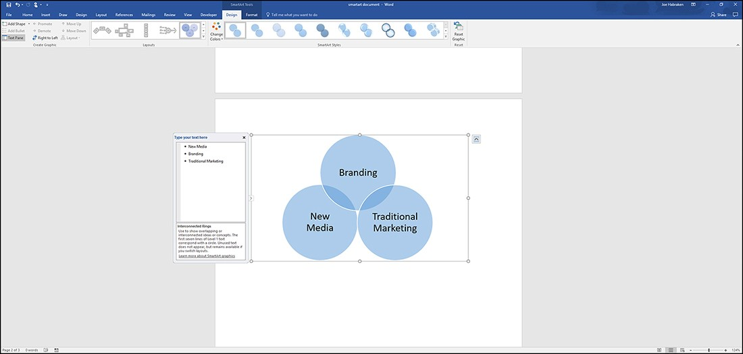
Modifying SmartArt graphics
The SmartArt Tools consist of a Design tab and a Format tab.
The Design tab is devoted to modifying the SmartArt elements. For example, the Create Graphic group on the Design tab enables you to add shapes and bullets as well as to promote or demote items in the SmartArt list.
The Change Colors command in the SmartArt Styles group enables you to specify a color combination for the SmartArt graphic based on the current theme, as well as a number of other color categories. The SmartArt Styles gallery to ﬁne-tune the use of the color scheme selected for the graphic and apply 3D styles to the SmartArt.
The SmartArt Tools Design tab

Slide 28
Modifying SmartArt graphics
The SmartArt Tools consist of a Design tab and a Format tab.
The Design tab is devoted to modifying the SmartArt elements. For example, the Create Graphic group on the Design tab enables you to add shapes and bullets as well as to promote or demote items in the SmartArt list.
The Change Colors command in the SmartArt Styles group enables you to specify a color combination for the SmartArt graphic based on the current theme, as well as a number of other color categories. The SmartArt Styles gallery to ﬁne-tune the use of the color scheme selected for the graphic and apply 3D styles to the SmartArt.
The SmartArt Tools Design tab

Slide 29
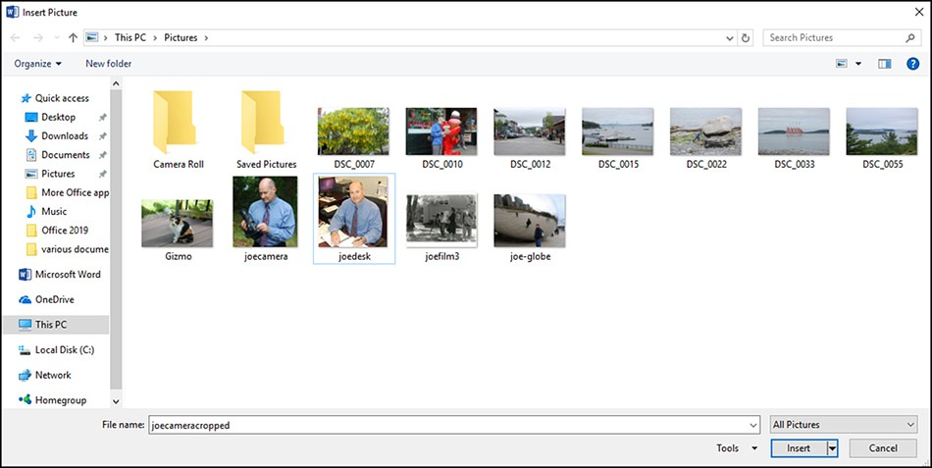
Working with your digital pictures
You can work with a number of diﬀerent digital picture ﬁle formats when working in the applications. It is true that a picture is worth a thousand words and you can use pictures to enhance your Word documents, PowerPoint slides, Excel worksheets, and even Outlook emails.
The Pictures command is on the Insert tab. To insert a picture, follow these steps:
Select the Pictures command. The Insert Picture dialog box opens.
Locate and select the picture ﬁle you want to insert.
Click the Insert button. The Insert Picture dialog box closes, and the picture is inserted into the document.
The Insert Picture dialog box

Slide 30
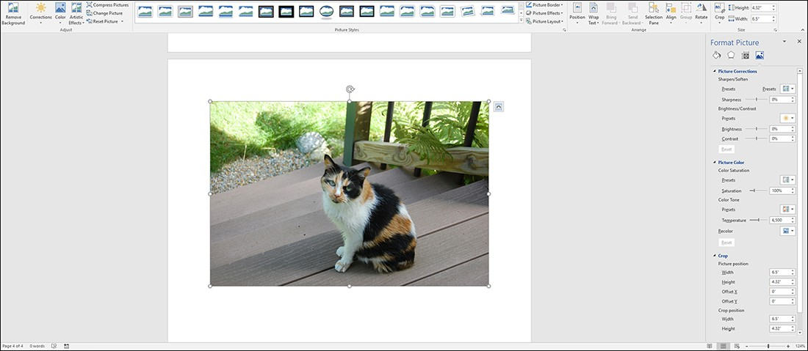
Adjusting pictures
If you select Picture Corrections Options at the bottom of the Corrections gallery (select Correction then Picture Corrections Options), the Format Picture task pane opens with Picture Corrections selected. You can use the diﬀerent settings in the Format Picture task pane to specify the ﬁll, the line color, the line style, and the 3D format and rotation for the image. You can also ﬁne-tune changes that you have made to the picture, such as brightness and contrast corrections, color changes, and artistic eﬀects (Click on picture – Format).
The Format Picture task pane

Slide 31
Cropping an image
Another useful command for adjusting an image is the Crop command. Although this command isn’t included in the Adjust group, the Crop command is useful when you want to trim unneeded parts of the image. It is located at the other end of the Format tab in the Size group.
The Crop command oﬀers more than one possibility for cropping an image. When you select the Crop command, the following options are provided: Crop, Crop to Shape, Aspect Ratio, Fill, Fit.
If you ﬁnd that you have gone overboard on the cropping, you can remove the cropping by using the Undo command on the Quick Access Toolbar.

Slide 32
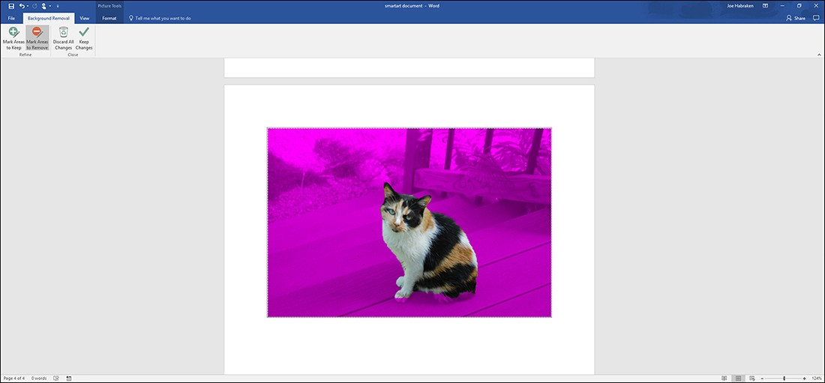
Using the Background Removal tool
The Background Removal tool can be extremely useful in removing unwanted background information from a picture so that the resulting image completely highlights the subject of the picture.
To use the Remove Background tool, select a photo in the Oﬃce application. Then go in Format and click on the Remove Background command. The commands provided on the Background Removal tab are self- explanatory (Click on picture – Format – Artistic Effects – or Remove Background).
The Background Removal tab and a selected picture

Slide 33
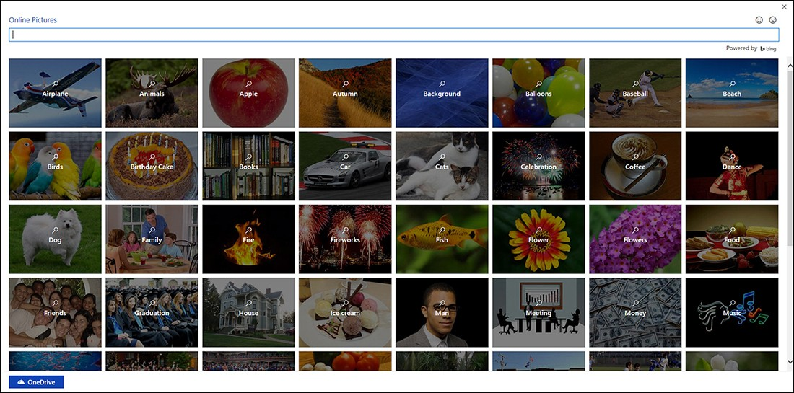
Inserting online pictures
The Microsoft Oﬃce applications provide you with the ability to source online pictures for your documents, worksheets, and slides. The Bing image search engine provides you with endless possibilities. Bing makes sure that all images located during the Bing search are licensed under Creative Commons. When you select the Online Pictures command on the ribbon’s Insert tab, the Online Pictures window opens, as shown in Figure.
The Online Pictures window

Slide 34
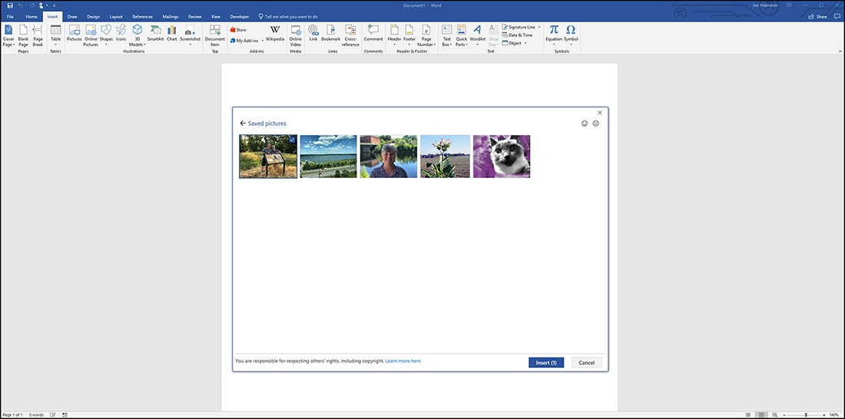
Inserting online pictures
Although the Online Pictures features has dropped direct access to Facebook and Flickr, you will ﬁnd that a Bing search allows you to access an endless number of images and clip art on the web. To run a web image search from the Online Pictures window, click in the Search Bing box and enter your keyword(s) for the search. As already mentioned in the previous section, by default, the Bing image search shows only images found (using your search criteria) that are licensed under Creative Commons.
The results of a Bing image search and the Creative Commons message

Slide 35
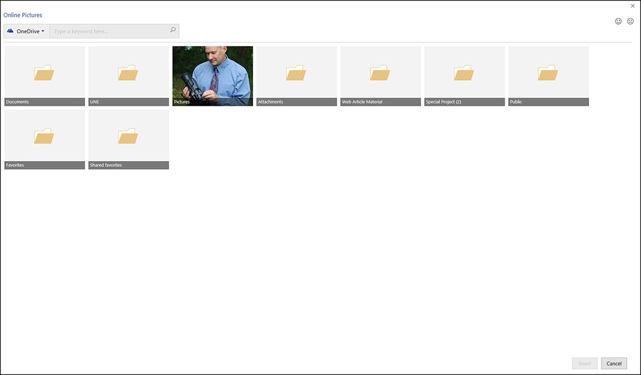
Inserting images from your One Drive
As mentioned earlier in the chapter, you can insert images from your OneDrive using the Pictures command or the Online Pictures command. So depending on your personal preference, you can treat your OneDrive as a local resource using the Pictures command or as an online resource accessed via the Online Pictures command. Select a folder to open it.
You can access photos stored on your OneDrive

Slide 36
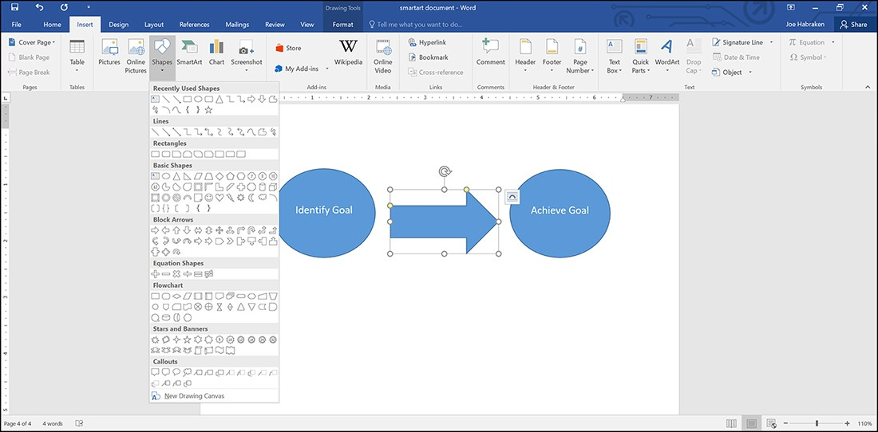
Using shapes and the Oﬃce drawing tools
The Microsoft Oﬃce applications enable you to add a variety of shapes to your Oﬃce documents. The Shapes gallery, which you access via the Shapes command on the Insert tab, provides shape categories. You can add lines, rectangles, block arrows, callouts, and other shape types.
Select a shape in the gallery. The pointer becomes a drawing tool, and you can use it to “draw” the shape on the document page, sheet, or slide. After inserting the shape, you can size it using the sizing handles provided when the shape is selected. You can also drag the shape in the document to position it.
Insert a shape from the Shapes gallery

Slide 37
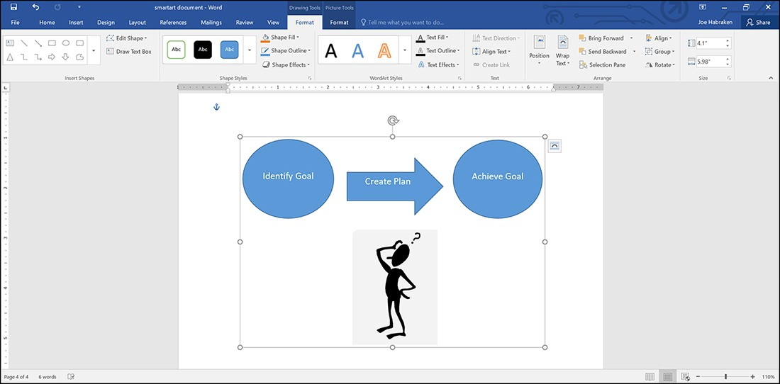
Adding and combining multiple shapes
To create a design element from multiple shapes in Word, Excel, or PowerPoint, insert the required shapes and position them as needed. Then use the Arrange commands to further position and layer the shapes.
You can use the Selection pane to change the layer position of the shapes by changing the shape’s position in the Selection list. You can also select shapes in the Selection pane (instead of trying to click items on the page) when you want to specify the shapes to be grouped. Figure shows multiple shapes selected on a Word document page. Note that the Selection pane provides a list of all the objects on the page (including one clip art picture and one photo). To open the Selection pane, select Selection Pane in the Arrange Group on the Drawing Tools Format tab. When you are ready to group the selected shapes (and other objects), select the Group Objects command in the Arrange group. Now, when you move or size one shape in the group, all the shapes in the group are moved or sized.
Group multiple shapes and objects

Slide 38
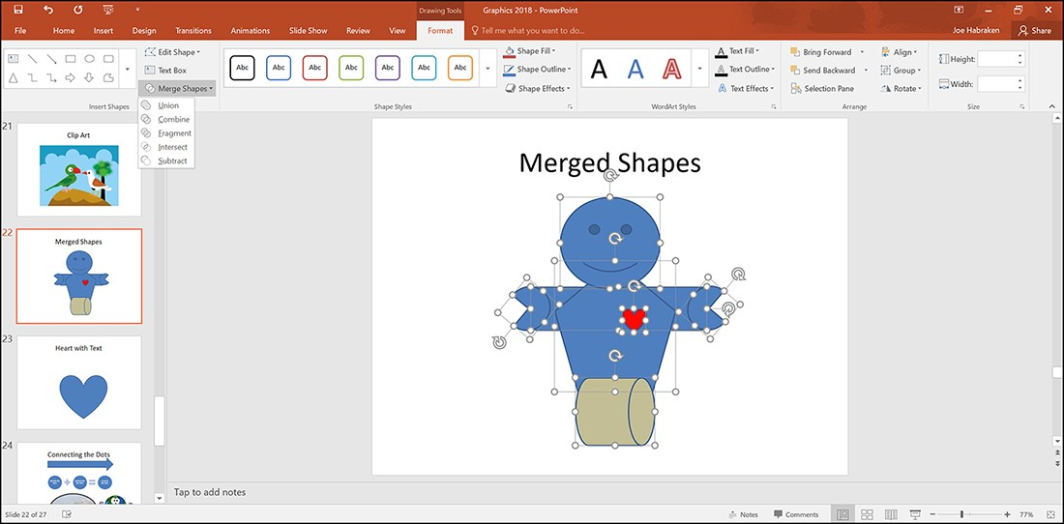
Adding and combining multiple shapes (cont.)
PowerPoint takes the capability to combine multiple shapes even further by oﬀering a Merge Shapes command. This command is available in the Insert Shapes group on the Drawing Tools, Format tab when you have multiple shapes selected on a slide. When you select Merge Shapes, you have ﬁve possibilities:
Union: Combines all the shapes into a single shape. You basically end up with a shape that incorporates the outline and internal volume of the original shapes. A one-color shape is created.
Combine: Combines the shapes into a single shape, where any overlapping parts of the original shapes are omitted. A single, color shape results.
Fragment: Combines the shapes into a one-color shape that outlines the exterior shape and any parts where the shapes originally overlapped.
Intersect: Creates a combined shape that shows only the parts that originally overlapped.
Subtract: Subtracts the overlapping shapes. For example, if you place an arrow on top of a circle and select Subtract, the circle would have an empty space within it in the shape of an arrow.

Slide 39
Formatting a shape with the drawing tools
The Drawing Tools, Format tab provides all the tools you need for formatting a shape.
Insert Shapes: This group provides the Shapes gallery and the Edit Shape, Draw A Text Box, and Merge Shapes commands. The Edit Shape command enables you to replace a selected shape or view the edit points on a shape. The edit points enable you to manipulate diﬀerent parts of a single shape. For instance, on a Smiley Face, the edit points give you control over the placement of the eyes and mouth on the face.
Shape Styles: This group enables you to apply shape styles to your shapes that include ﬁll, outline, and text color formatting. You can ﬁne-tune the style for a shape using the Shape Fill, Shape Outline, and Shape Eﬀects commands. The Shape Eﬀects command enables you to apply diﬀerent eﬀects to the shape, such as Shadow, Reﬂection, and Glow. You can also use the 3D Rotation option to add 3D eﬀects to the shape.
WordArt Styles: This group becomes available when you have added text to the shape. You can apply WordArt styles to the text and manipulate the ﬁll, outline, and eﬀects for the text. The Text Eﬀects command provides Shadow, Reﬂection, and Bevel eﬀects, as well as 3D rotation eﬀects.
Text: This group (available in Word) provides commands for formatting the text in the shape. You can change the text direction and alignment within the shape. When you create multiple text boxes (which, again, can be any shape), you can link the shapes containing text using the Create Link command, which causes the text to ﬂow through the linked text containing shapes.
Arrange: This group enables you to position the shape with the text layer in a document. In Word, the Position command speciﬁes whether the shape is in line with the text. The Wrap Text command then speciﬁes how the text actually wraps around the shape. This group also provides the Bring Forward, Send Backward, and Group commands. PowerPoint includes this group but does not provide the Position Wrap Text commands.
Size: This group contains the Shape Height and Shape Width spin boxes, which are used to size the selected shape.

Slide 40
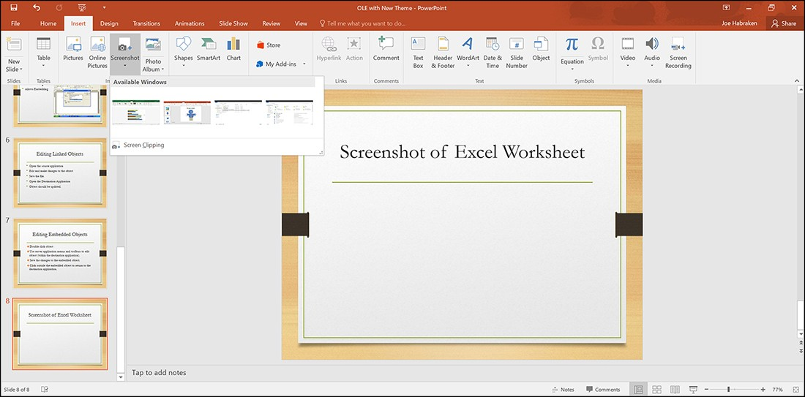
Using the screenshots feature
The screenshot feature enables you to capture a screenshot of an open application or a speciﬁc area of an application window by using the Screen Clipping tool. You can capture screenshots in Word, Excel, PowerPoint, and Outlook (when creating new email messages, appointments, tasks, and contacts).
The Screenshot command is housed in the Illustrations group on the ribbon’s Insert tab, except for in PowerPoint, where it resides in the Images group on the Insert tab. To capture an entire window, follow these steps:
Open the application window that you want to capture in the screenshot.
Switch to the Oﬃce application that will serve as the destination for the screenshot. For example, you might insert the screenshot into a Word document or onto a PowerPoint slide.
Select the Screenshot command. An Available Windows gallery appears.
Select the window you want to capture. The entire application window is pasted as a screenshot into the current Oﬃce application.

Slide 41
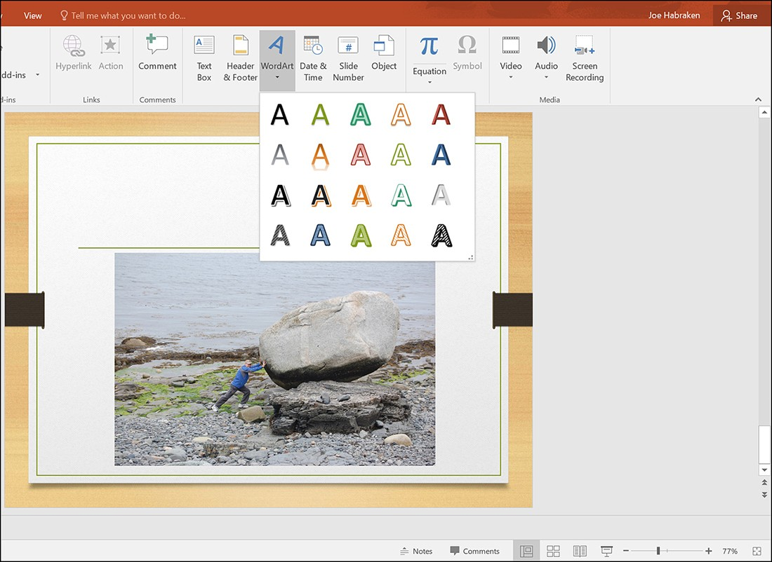
Using Word Art
WordArt enables you to create interesting text eﬀects within your Oﬃce application documents. You can use WordArt boxes on PowerPoint slides or as graphic elements in a Word document or an Excel worksheet. You can create a WordArt object from existing text, or you can create a blank WordArt object and then type the required text directly in the WordArt frame.
The WordArt command is on the ribbon’s Insert tab. It is available in Word, PowerPoint, Excel, and Publisher. It is also available in Outlook when you are creating new Outlook items such as emails, contacts, and appointments.

Slide 42
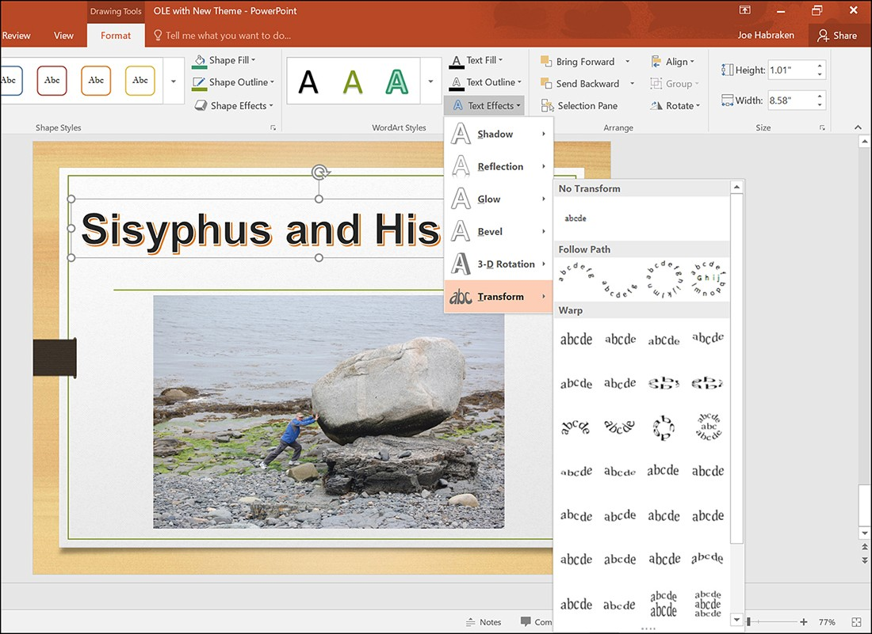
Using Word Art
The Text Fill and Text Outline commands enable you to control the ﬁll for the WordArt text characters and the outline of the characters, respectively. The really cool part of using WordArt, however, lies in the diﬀerent text eﬀects that you can apply to the WordArt via the Text Eﬀects command. The Text Eﬀects gallery enables you to apply eﬀects to the WordArt text, including Show, Reﬂection, Glow, and 3D Rotation. In terms of working with the WordArt object, the other Format tab command groups enable you to manipulate the text direction and alignment as well as determine how the object is positioned in relation to existing text in the Oﬃce document. For even more control over the WordArt text eﬀects, right-click the WordArt and select Format Shape to display the Format Shape task pane, which provides Shape Attributes such as Fill and Line Color. The Format Shape task pane also enables you to manipulate text eﬀects such as 3D Format and Rotation.

Slide 43

Quick “In class Mock test”
Which of the following best describes the Ribbon?
A slider that can be used to zoom the document
A feature that translate the text into any language
A toolbar with various commands
A cable that connect the computer with the printer

Slide 44
Quick “In class Mock test”
In order to save an existing document with a different name you need to:
Retype a document and give it the different name.
Used the Save as… command.
Copy and save the original document to a new document and then save.
Use Windows Explorer to copy the document to a different location and then rename it.

Slide 45
Quick “In class Mock test”
The ______________ contains all of the commands you'll need in order to perform common tasks.
header
ribbon
save
red line

Slide 46
Quick “In class Mock test”
When you are editing a document you are ______________________.
creating new content
copying someone else's content
correcting or modifying a document
none of the above

Slide 47
Quick “In class Mock test”
What button reverses the most previous action?
Review
Redo
Undo
Delete or Backspace

Slide 48
Useful links
https://support.microsoft.com/en-us/office/word-for-windows-training-7bcd85e6-2c3d-4c3c-a2a5-5ed8847eae73
Word for Windows trainig

Slide 49
Thank you for your attention!

